Slide 1
Unit 4
CSBS Sem VIII

Slide 2
Risk Analysis
Project Control
Project Audit
Project Termination

Slide 3
Risk Management
Risk Management is the process of defining how to conduct risk management activities for a project.
Most Common Project Risks
Cost risk, typically escalation of project costs due to poor cost estimating accuracy and scope creep.
Schedule risk, the risk that activities will take longer than expected. Slippages in schedule typically increase costs and, also, delay the receipt of project benefits, with a possible loss of competitive advantage.
Performance risk, the risk that the project will fail to produce results consistent with project specifications.

Slide 4
Risk Management
Other Types of Risks
There are many other types of risks of concern to projects. These risks can result in cost, schedule, or performance problems and create other types of adverse consequences for the organization. For example:
Governance risk relates to board and management performance with regard to ethics, community stewardship, and company reputation.
Strategic risks result from errors in strategy, such as choosing a technology that can’t be made to work.

Slide 5
Risk Management
Operational risk includes risks from poor implementation and process problems such as procurement, production, and distribution.
Market risks include competition, foreign exchange, commodity markets, and interest rate risk, as well as liquidity and credit risks.
Legal risks arise from legal and regulatory obligations, including contract risks and litigation brought against the organization.
Risks associated with external hazards, including storms, floods, and earthquakes; vandalism, sabotage, and terrorism; labor strikes; and civil unrest.

Slide 6
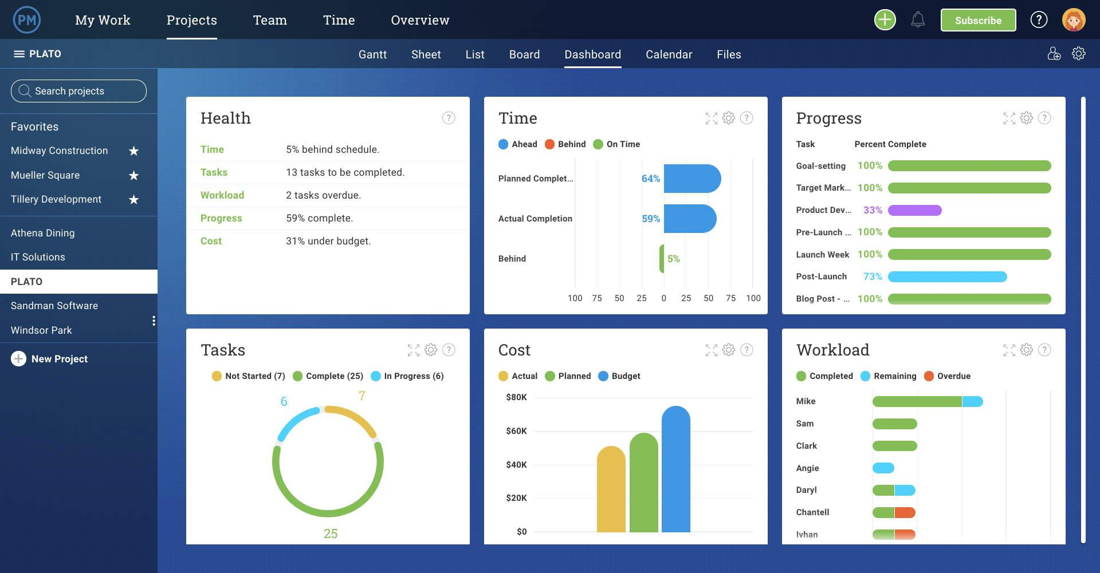

Slide 7
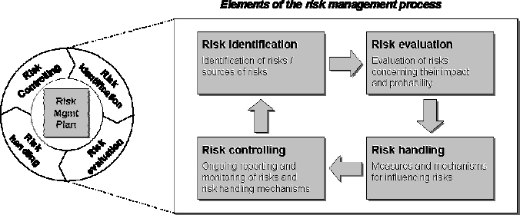
Risk Management

Slide 8
Risk Management
Risk Identification
Risks are to be identified and dealt with as early as possible in the project.
Risk identification is done throughout the project life cycle
Risk identification is one of the key topics in the regular project status and reporting meetings. Some risks may be readily apparent to the project team—known risks; others will take more rigor to uncover, but are still predictable.

Slide 9
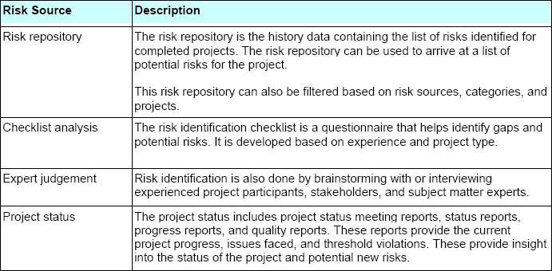
Risk Management
Risk Identification :
Risk Sources

Slide 10
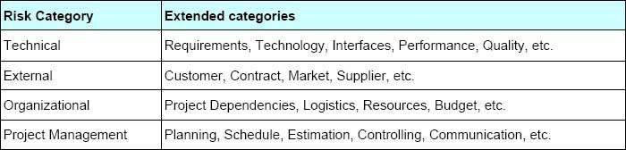
Risk Management
2. Risk Category
Risk category provides a list of areas that are prone to risk events. The organization recommends high-level, standard categories

Slide 11
Risk Management
Risk analysis involves examining how project outcomes and objectives might change due to the impact of the risk event.
Once the risks are identified, they are analysed to identify the qualitative and quantitative impact of the risk on the project so that appropriate steps can be taken to mitigate them.

Slide 12
Risk Management
Probability of Risk Occurrence
High probability – (80 % ≤ x ≤ 100%)
Medium-high probability – (60 % ≤ x < 80%)
Medium-Low probability – (30 % ≤ x < 60%)
Low probability (0 % < x < 30%)
Risk Impact
High – Catastrophic (Rating A – 100)
Medium – Critical (Rating B – 50)
Low – Marginal (Rating C – 10)

Slide 13
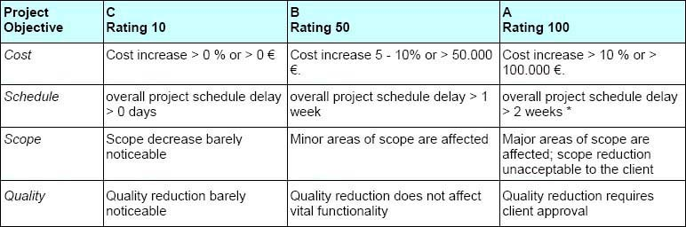
Risk Management

Slide 14
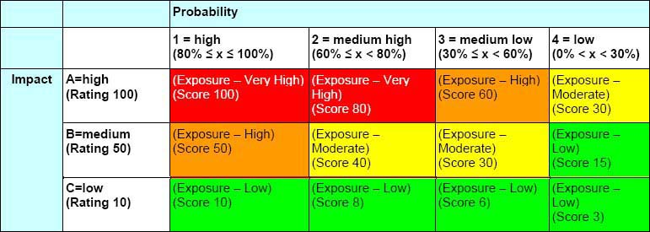
Risk Management
3. Risk Exposure
Risk Exposure or Risk Score is the value determined by multiplying the Impact Rating with Risk Probability.

Slide 15
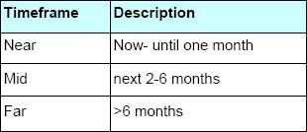
Risk Management
Risk Occurrence Timeframe

Slide 16
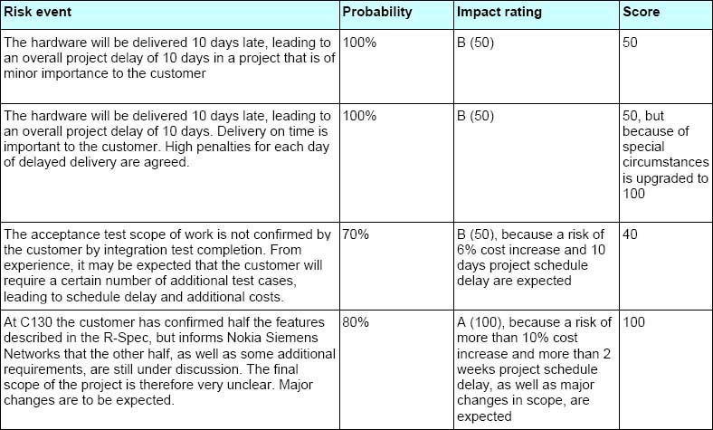
Risk Management
Risk Classification Examples:

Slide 17
Risk Management
4. Risk Response Planning
There may not be quick solutions to reduce or eliminate all the risks facing a project. Some risks may need to be managed and reduced strategically over longer periods. Therefore, action plans should be worked out to reduce these risks. These action plans should include:
Risk description with risk assessment
Description of the action to reduce the risk
Owner of the risk action
Committed completion date of the risk action

Slide 18
Risk Management
Risk Response Plans
For each risk, a risk response must be documented in the risk register in agreement with the stakeholders. This should be ensured by the project manager.
Risk response plans are aimed at the following targets:
Eliminating the risk
Lowering the probability of risk occurrence
Lowering the impact of the risk on the project objectives

Slide 19
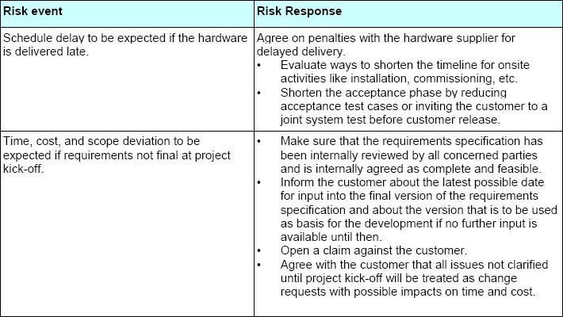
Risk Management

Slide 20
Risk Management
5. Risk Ownership:
The ground rule is that responsibility for managing all risks in the project lies with the project manager.
Based on this ground rule a Risk Owner (who is not necessarily the project manager) must be determined and named in the Risk Register.

Slide 21
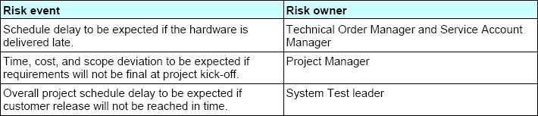
Risk Management

Slide 22
Risk Management
6. Risk monitoring and control :
Identifying new risks and planning for them
Keeping track of existing risks to check if:
Reassessment of risks is necessary
Any of risk conditions have been triggered
Monitor any risks that could become more critical over time
Tackle the remaining risks that require a longer-term, planned, and managed approach with risk action plans

Slide 23
Risk Management
7. Risk reporting:
The risk register is continuously updated, from risk identification through risk response planning and status update during risk monitoring and control. This project risk register is the primary risk reporting tool and is available in the central project server, which is accessible to all stakeholders.

Slide 24
Project Monitoring & Control
Project controlling is the application of processes to measure performance against the plan.
Controlling helps identify deviations from the plan.
Project management helps manage different processes, while project control ensures they are performed as planned.
Project Control focuses on the following:
Project Budget
Project Schedule
Project Quality

Slide 25
Project Monitoring & Control
Features:
1. It is Forward-Looking
Controlling helps organizations plan and manage their projects. It allows an organization to identify areas of risk and realize opportunities.
2. It Exists at all Levels
Controlling is from the top management to the operational level. This ensures plans are aligned with operations and resources are used efficiently.

Slide 26
Project Monitoring & Control
3. It is a Continuous Process
Controlling is not a one-time event; project managers continually monitor their progress and compare it with the planned progress.
This allows organizations to be proactive rather than reactive when managing resources.

Slide 27
Project Monitoring & Control
4. It is a Preventive Mechanism
Controlling helps organizations identify and address potential problems before they escalate. This allows organizations to take corrective action before it’s too late.
5. It Provides Feedback
Feedback provides organizations with information about the effectiveness of their strategies and how to improve further.
The controlling mechanism provides an organization with valuable feedback.

Slide 28
Project Monitoring & Control
6. It is Flexible
Controlling can be adjusted according to the project needs, such as changes in market conditions or new government regulations.
This allows organizations to adapt their controlling processes when necessary.

Slide 29
Project Monitoring & Control
Project monitoring and control process includes procedures which are performed to observe project performance so that potential problems are identified, and appropriate action can be taken to meet the desired performance of the project.
The goal of Project Monitoring and Control (PMC) is to ensure that whether the project proceeds according to the activities that are planned or not. It helps to develop an understanding of project progress, which helps in taking appropriate actions to control deviations of plans.

Slide 30
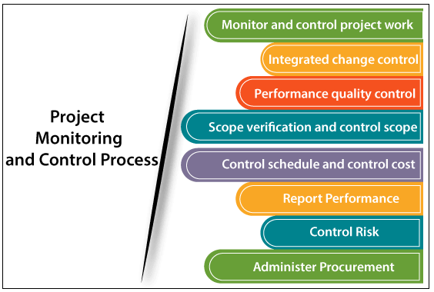
Project Monitoring & Control
There are several processes in Project Monitoring and Control as follows:-

Slide 31
Project Monitoring & Control
Monitor and control project work - It helps to check whether the team is working according to plan or not and able to complete the project on time. Project managers make performance measures or use previous performance measures to analyze project performance at regular intervals during the development of the project.

Slide 32
Project Monitoring & Control
Integrated change control - Project manager, always try to avoid the changes and control them if changes occur. Change is required, but there is no compulsion. If it requires a change, the project manager discusses with the consultants, senior management, or other stakeholders, including customer and try to find out the solution.

Slide 33
Project Monitoring & Control
Activities during this change control:
Keeps a record of all the changes made to the previous baseline to reach a new baseline
Identify all items to define the software configuration
Monitor status of change requests
Complete listing of all changes since the last baseline
Allows tracking of progress to next baseline
Allows to check previous releases/versions to be extracted for testing

Slide 34
Project Monitoring & Control
Scope verification and control scope - The project manager controls the scope all over the development phases. The customer will verify the scope to check whether the developed product fulfills all the requirements of the customer’s or not. If it meets the requirements, then it is delivered to the customer's site, and if not, then it should again go back to the development stage.

Slide 35
Project Monitoring & Control
Control schedule and control cost - With the help of Earned Value Management (EVM), the project manager controls the schedule and cost of the project. With the help of Earned Value Management (EVM), the project manager control the timing and cost of the project, and depending upon the results of CPI(Cost Performance Index) and SPI(Schedule Performance Index) project is monitored and controlled.

Slide 36
Project Monitoring & Control
Planned Value (PV)
It is the planned expenditure of funds to the date of analysis.
PV = Planned Completion (%) * BAC
Where BAC = budget at completion
Earned Value (EV)
It is the actual progress of the task to the date of analysis.
Earned Value = Actual Completion (%) * BAC
Actual Cost (AC)
It is the actual expenditure of funds to the date of analysis.

Slide 37
Project Monitoring & Control
Cost Variance (CV)
The amount that the project is above or below the budget at the point of analysis.
Cost Performance Index (CPI)
The amount that the project is above or below budget, relative to the overall size of the project.
If CPI > 1, Project Cost is below Budget.
If CPI < 1, Project Cost is over Budget.

Slide 38
Project Monitoring & Control
Schedule Variance
The amount that the project is ahead or behind schedule at the point of analysis.
Schedule Performance Index
The amount that the project is ahead or behind schedule, relative to the overall size of the project.
If SPI > 1, Project is ahead its Schedule
If SPI < 1, Project is behind its Schedule

Slide 39
Project Monitoring & Control
Problem 1: Suppose you have a budgeted cost of a project at $900,000. The project is to be completed in 9 months. After a month, you have completed 10 percent of the project at a total expense of $100,000. The planned completion should have been 15 percent. Calculate Planned value and earned value.

Slide 40
Project Monitoring & Control
Given,
BAC = $ 900,000
AC = $ 100,000
Calculate,
Planned Value
Earned Value
We have,
planned completion (%) = 15 %
actual completion (%) = 10 %

Slide 41
Project Monitoring & Control
PV = Planned Completion (%) * BAC
= 15% * $900,000
= $135,000
EV = Actual Completion (%) * BAC
= 10% * $900,000
= $90,000

Slide 42
Project Monitoring & Control
Calculate,
CPI
SPI
CPI = EV/AC
= 90,000/ 100,000
= 0.90
SPI = EV/PV
= 90,000/ 135,000
= 0.67
CV = EV – AC
SV = EV – PV

Slide 43
Project Monitoring & Control
Problem 2: Suppose you are managing a software development project. The project is expected to be completed in 8 months at a cost of $10,000 per month. After 2 months, you realize that the project is 30 percent completed at a cost of $40,000. You need to determine whether the project is on-time and on-budget after 2 months.

Slide 44
Earned Value Analysis
Given,
BAC = 8 * 10,000 = $ 80,000
AC = $ 40,000
Calculate,
Planned Value, CV, SV
Earned Value
We have,
planned completion (%) = 2/8 = 25 %
actual completion (%) = 30 %
PV = Planned Completion (%) * BAC
=
=
EV = Actual Completion (%) * BAC
=
=
CV = EV – AC
SV = EV - PV

Slide 45
Earned Value Analysis
Given,
BAC = 8 * 10,000 = $ 80,000
AC = $ 40,000
Calculate,
Planned Value
Earned Value
We have,
planned completion (%) = 2/8 = 25 %
actual completion (%) = 30 %
PV = Planned Completion (%) * BAC
= 25 % * 80,000
= 20,000
EV = Actual Completion (%) * BAC
= 30 % * 80,000
= 24,000

Slide 46
Earned Value Analysis
Calculate,
CPI
SPI
CPI = EV/AC
=
=
SPI = EV/PV
=
=
CPI 1, Project is Budget.
SPI 1, Project is Schedule.

Slide 47
Earned Value Analysis
Calculate,
CPI
SPI
CPI = EV/AC
= 24,000/ 40,000
= 0.6
SPI = EV/PV
= 24,000/ 20,000
= 1.2
CPI < 1, Project is Over Budget.
SPI > 1, Project is Ahead Schedule.
Calculate CV and SV

Slide 48
Project Monitoring & Control
Perform quality control - Before delivering the product to the customer, the developed product is verified again to check that the product we are giving to the customer is delivered with the required quality. There are a lot of quality tools and processes to check the quality of the product, like test cases, Root Cause Analysis, Control chart, Histogram, etc.

Slide 49
Project Monitoring & Control
Report performance – Large projects would have many stakeholders. The project manager will update the project performance to the stakeholders. This process collects performance information like status reports, progress reports, and forecasts.
Control risk – Project managers also monitor the risks involved with the project. The project may have different types of risks, including process, people (internal, customer, vendor), tools, and technology.

Slide 50
Project Monitoring & Control
Administer Procurement - If any process is handed over to the third-party, their performance should also be monitored. Based on their performance, the outcome of the project is decided. The project manager also needs to monitor the role and responsibility of the third-party.
Benefits of Process Monitoring and Control
It helps in the better control of the project
It provides an in-depth knowledge of the progress of the project.
It helps in maintaining coordination among team members.
It helps in monitoring and managing the project process.

Slide 51
Project Audit
A project audit is a formal review of a project, often intended to assess the extent to which project management standards are being upheld.
Audits are generally carried out by a specially designated audit department, the Project Management Office, an approved management committee or an external auditor.

Slide 52
Project Audit
Objectives of project audit:
1. Ensure the quality of products and services
A project audit acts as a quality assurance tool. It reviews the project life cycle evaluating the results yielded during the different stages, from the design phase to implementation.
When reviewing the design phase, a project audit evaluates the thoroughness of the design concepts, including the analysis of alternative designs.
The identification of the errors during the process contributes to the resolution of the problems and to understand if the project should continue through a go/no-go decision at each stage.

Slide 53
Project Audit
2. Ensure the quality of project management
A project audit ascertains that the project management satisfies the standards by assessing whether it complies with the organization's policies, processes and procedures.
It evaluates the methodology used to help identify gaps in order to introduce the required improvements.

Slide 54
Project Audit
3. Identify the business risk
Project audits support the identification of business factors where risks may reside, which could affect budget, time, environment and quality.
The project audit assesses the feasibility of the project in terms of affordability and performance by providing transparency and assessing costs, time and resources.

Slide 55
Project Audit
4. Improve project performance
The monitoring of the various phases of the project life cycle can contribute to the improvement of the project team’s performance.
The audit also helps to improve the budget and resource allocation.
Identifying priorities, corrective measures and preventive actions can lead to a positive project outcome.
The troubleshooting process allows the project team to provide solutions and helps prevent similar problems from recurring in the future.

Slide 56
Project Audit
5. Learn
A project audit can deliver learning opportunities through assessments of project management expertise.
Providing reviews and feedback allows individuals and project teams to ponder their own performance.

Slide 57
Project Audit
Steps in Project Audit
1. Project Audit Initiation This step involves starting the audit process, defining the purpose and scope of the audit, and gathering sufficient information to determine the proper audit methodology.

Slide 58
Project Audit
2. Project Baseline Definition This phase of the cycle normally consists of identifying the performance areas to be evaluated, determining standards for each area through benchmarking or some other process, ascertaining management performance expectations for each area, and developing a program to measure and assemble the requisite information.

Slide 59
Project Audit
3. Establishing an Audit Database: Once the baseline standards are established, execution of the audit begins. The next step is to create a database for use by the audit team.
Depending on the purpose and scope of the audit, the database might include information needed for assessment of project organization, management and control, past and current project status, schedule performance, cost performance, and output quality, as well as plans for the future of the project. The information may vary from a highly technical description of performance to a behaviorally based description of the interaction of project team members.

Slide 60
Project Audit
4. Preliminary Analysis of the Project After standards are set and data collected, judgments are made. Some auditors do judgment on the grounds that such a delicate but weighty responsibility must be reserved to senior management.
The auditor must analyze the data and then present the analysis to managers in ways that communicate the
real meaning of the audit’s findings. It is the auditor’s duty to brief the PM on all findings and judgments before releasing the audit report management.

Slide 61
Project Audit
5. Audit Report Preparation This part of the audit life cycle includes the preparation of the
audit report, organized by whatever format has been selected for use.
A set of recommendations, together with a plan for implementing them, is also a part of the audit report. If the recommendations go beyond normal practices of the organization, they will need support from the policy-making level of management.

Slide 62
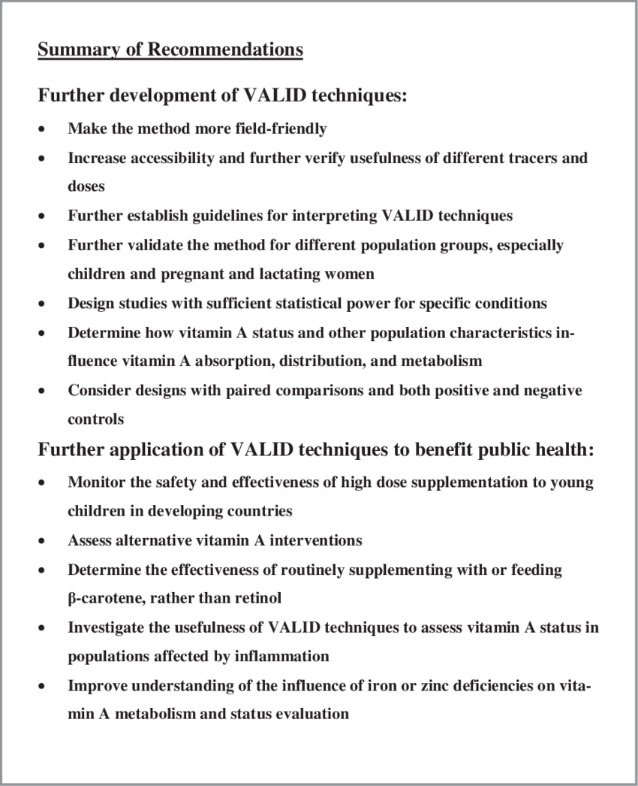
Project Audit

Slide 63
Project Termination
A project can be said to be terminated when work on the substance of the project has ceased or slowed to the point that further progress on the project is no longer possible
There are four fundamentally different ways to close out a project:
extinction, addition, integration, and starvation.

Slide 64
Project Termination
1. Termination by Extinction
The project is stopped. It may end because it has been successful and achieved its goals
The new product has been developed and handed over to the client, or the software has been installed and is running.
The project may also be stopped because it is unsuccessful or has been superseded:
e.g: The new drug failed its efficacy tests; there are better/faster/cheaper/prettier alternatives available;
or it will cost too much and take too long to get the desired performance.

Slide 65
Project Termination
A special case of termination by extinction is “termination by murder.”* There are all
sorts of murders. They range from political assassination to accidental projecticide. When
senior executives vie for promotion, projects for which the loser is champion are apt to suffer.
Corporate mergers often make certain projects redundant or irrelevant.

Slide 66
Project Termination
When a decision is made to terminate a project by extinction, the most noticeable event is that all activity on the substance of the project ceases.
A great deal of organizational activity, however, remains to be done. Arrangements must be made for the orderly release of project team members and their reassignment to other activities if they are to remain in the parent organization.

Slide 67
Project Termination
2. Termination by Addition
Most projects are “in-house,” that is, carried out by the project team for use in the parent organization.
If a project is a major success, it may be terminated by institutionalizing it as a formal part of the parent organization.
When project success results in termination by addition, the transition is strikingly different from termination by extinction.

Slide 68
Project Termination
Project personnel, property, and equipment are often simply transferred from the dying project to the newly born division.
The metamorphosis from project to department,
to division, and even to subsidiary is accompanied by budgets and administrative practices that conform to standard procedure in the parent firm, by demands for contribution profits.

Slide 69
Project Termination
Termination by Integration
This method of terminating a project is the most common way of dealing with successful projects, and the most complex.
The property, equipment, material, personnel, and functions of the project are distributed among the existing elements of the parent organization.
The output of the project becomes a standard part of the operating systems of the parent, or client.

Slide 70
Project Termination
Following is a list of a few of the more important aspects of the transition from project to integrated operation that must be considered when the project functions are distributed:
1. Personnel 2.Accounting/Finance
3. Information system/software 4. Marketing
5. Purchasing 6. Risk Identification& mgmt

Slide 71
Project Termination
4. Termination by Starvation
It is “slow starvation by budget decrement.” Almost anyone who has been involved with projects over a sufficient period of time to have covered a business recession has had to cope with budget cuts.
In some firms, for example, it is politically dangerous to admit that one has championed a failure, and terminating a project that has not accomplished its goals is an admission of failure.

Slide 72
Project Termination
In such a case, the project budget might receive a deep cut—or a series of small cuts—large enough to prevent further progress on the project and
to force the reassignment of many project team members.
In effect, the project is terminated, but the project still exists as a legal entity complete with sufficient staff to maintain some sort of presence.

Slide 73
Project Termination
WHEN TO TERMINATE A PROJECT
• Is the project still consistent with organizational goals?
• Is it practical? Useful?
• Is management sufficiently enthusiastic about the project to support its implementation?
• Is the scope of the project consistent with the organization’s financial strength?
• Is the project consistent with the notion of a “balanced” program in all areas of the organization’s technical interests? In “age”? In cost?
• Does the project have the support of all the departments (e.g., finance, manufacturing, marketing, IT, legal, etc.) needed to implement it?
• Is organizational project support being spread too thin?
• Is support of this individual project sufficient for success?
• Does this project represent too great an advance over current technology? Too small an advance?

Slide 74
Project Termination
• Is the project team still innovative, or has it gone stale?
• Can the new knowledge be protected by patent, copyright, or trade secret?
• Could the project be farmed out without loss of quality?
• Is the current project team properly qualified to continue the project?
• Does the organization have the required skills to achieve full implementation or
exploitation of the project?
• Has the subject area of the project already been “thoroughly plowed”?
• Has the project lost its key person or champion?
• Is the project team enthusiastic about success?
• Can the potential results be purchased or subcontracted more efficiently than developed
in-house?
• Does it seem likely that the project will achieve the minimum goals set for it? Is it still profiable? timely?

Slide 75
Case Study 1
Tornado IPT Case Study
Working with Tornado IPT
The Tornado Integrated Project Team (Tornado IPT) is part of the UK Ministry of Defence’s (MoD’s) Defence Equipment and Support (DE&S) organisation. It is responsible for the provision of logistical support and capability development for the RAF Tornado F3 (Air Defence Variant) and the GR4 (Ground Reconnaissance) fleet until 2025, when it is due to be replaced by the Eurofighter Typhoon. Between now and then it is the task of the IPT to ensure the platform’s capability is developed to meet the UK’s changing defence requirements.
The requirement to drive down defence costs whilst maintaining outputs to the end customer has led the IPT instigating a transformation programme which has resulted in the development of a series of availability-based contracting solutions with industry. The Tornado IPT draws Case study on the extensive aircraft design, development, operational and repair expertise of a team that includes the RAF, BAE Systems, Rolls Royce Defence Aerospace and QinetiQ.

Slide 76
Case study 2
Working with LLW Repository Ltd
LLW Repository Ltd (LLWR) is a waste management company that provides services to customers to treat and dispose of low-level radioactive waste (LLW). It manages the national Low-Level Waste Repository in West Cumbria on behalf of the Nuclear Decommissioning Authority (NDA), overseeing a National LLW Programme to ensure that lower activity waste is managed effectively across the UK.
After a competitive evaluation, LLWR appointed Risk Decisions to implement an integrated risk database solution to embed risk management.
Challenge
Prior to 2007, when LLWR was established as an independent Site Licence Company, LLWR’ s risk team had very little control over its shared systems. Moving away from spreadsheet-based methods towards more scalable solutions was part of the business’s growth plans.
LLWR’s Project Controls Manager, Sarah Moore, explains, “A new parent body organisation taking ownership of LLWR in 2008 was the opportunity for change. To that point, risk management was something that had been done to the organisation as opposed to being embedded within it. We wanted to have a tool that the organisation could use to demonstrate the value of our risk processes.”
“We were looking for a tool that would integrate all of our risk data, and provide us with analytical capability – basically a one-stop-shop for risk management. Given the industry we work in, the tool also needed to have a robust audit trail.”

